Slide 1
IntelliWeb
Intelligent web page classification
By:
FNU Vivek
Rithish Koneru
Aayushi Agrawal
Ravindersingh Rajpal
Group: P08

Slide 2
MOTIVATION
Explosive growth on the Internet, with millions of web pages on every topic
Important task is to collect relevant information from Web
Typical search engines usually include invalid links and irrelevant web-pages through keyword inputs
Need web-page classification for facilitating user searches
Web-page classification is the primary requirement for search engines, which retrieve documents in response to the user query

Slide 3
BACKGROUND
The Web provides dynamically changing environment, which makes it difficult to build a classification model that can fit to classify different web pages.
Many experiments like text based classification, link based classification have been done to enhance the efficiency of classification.
After literature review, various studies show that linear SVM performs better for web page classification.
Naïve Bayes being a probabilistic model also works well for text classification.
Sequence models in Deep Learning such as LSTMs have been known to perform well in text-based classification.

Slide 4
AGENDA
Discussion about IntelliWeb Approach
Classification Algorithms used:
Naïve Bayes with TF-IDF vectorization
Support Vector Machine with TF-IDF vectorization
GloVe based LSTM
Evaluation results after 5 fold cross validation
Conclusion
Limitations
Future Work

Slide 5
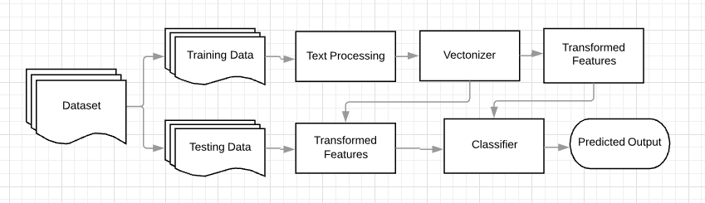
WORKFLOW & DATASET (WebKb)
classes | Student | Faculty | Staff | Department | Course | Project | Other
# docs | 1641 | 1124 | 137 | 182 | 930 | 504 | 3764
http://www.cs.cmu.edu/~webkb/

Slide 6







TECH STACK

Slide 7
NAÏVE BAYES
Naive Bayes Assumption
Conditional independence among the features
Simple and Effective
Lower computation complexity for large number of features
Uses probability of each attribute in each class
Frequency of words transformed to conditional probabilities
We use Multinomial Naive Bayes
Two documents are said to be correlated if they belong to the same category specified by the conditional probabilities based on the frequency of word

Slide 8
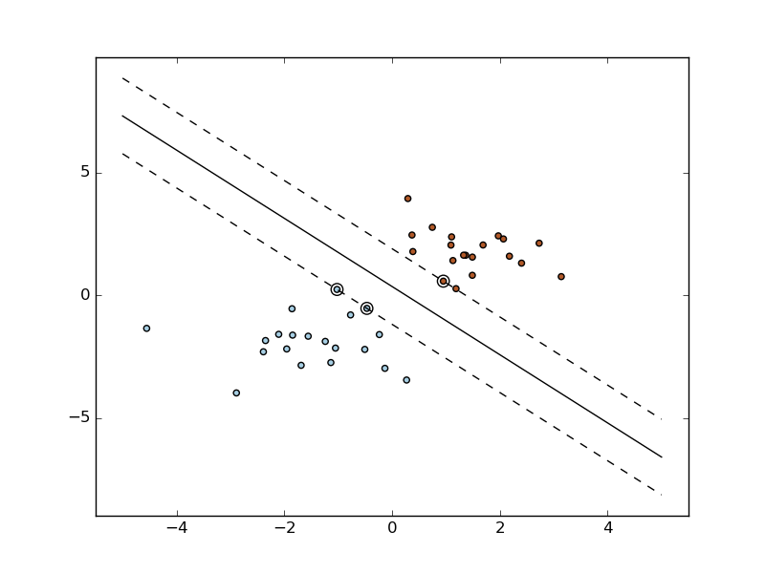
SUPPORT VECTOR MACHINE
Classify data using single or multiple hyperplanes.
Less prone to overfitting.
Can be trained in higher dimensions using "kernel trick".
Computationally inexpensive compared to other classifiers.
Input vector
Preprocessed data of web page content using NLTK.
TF-IDF Vectorization of preprocessed text.
Performed Grid Search for SVM
Best parameters: C = 10 and kernel = ‘linear’.
Various modifications of features tested with the inclusion of title of the webpage and hyperlinks.
Source: https://scikit-learn.org

Slide 9
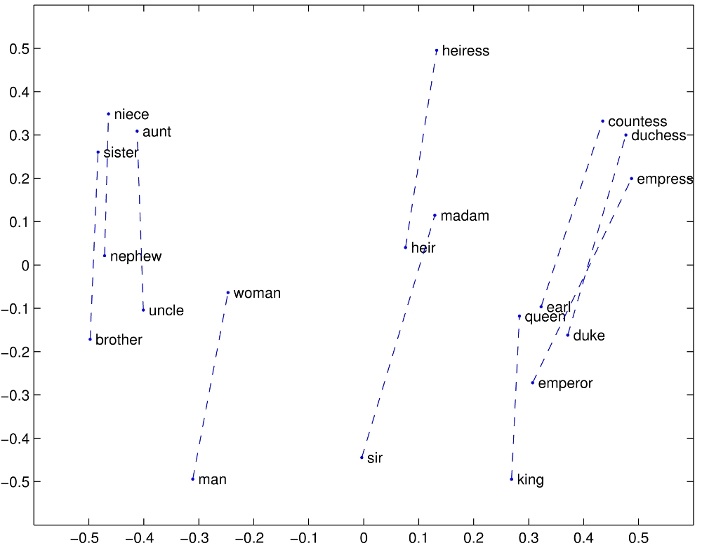
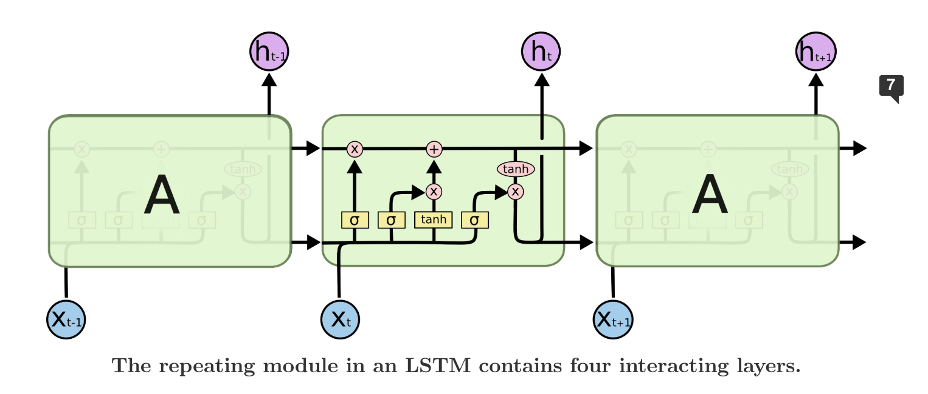
GloVe and LSTM
Global word-word co-occurrence matrix
Log-bilinear model with a weighted least-squares objective
Word vector such that dot product equals the logarithm of the words' probability of co-occurrence
Embed 'glove.6B.100d.txt' in our corpus
LSTM - Long Short-term Memory
Special kind of Recurrent Neural Network, learn long term dependencies
Cell state regulated by structures called gates
Forget gate - Sigmoid layer to throw away information
Input gate - tanh layer to update cell state
Output gate - tanh layer used to filter what to output
Source: https://nlp.stanford.edu/projects/glove/
Source: http://colah.github.io/posts/2015-08-Understanding-LSTMs/

Slide 10
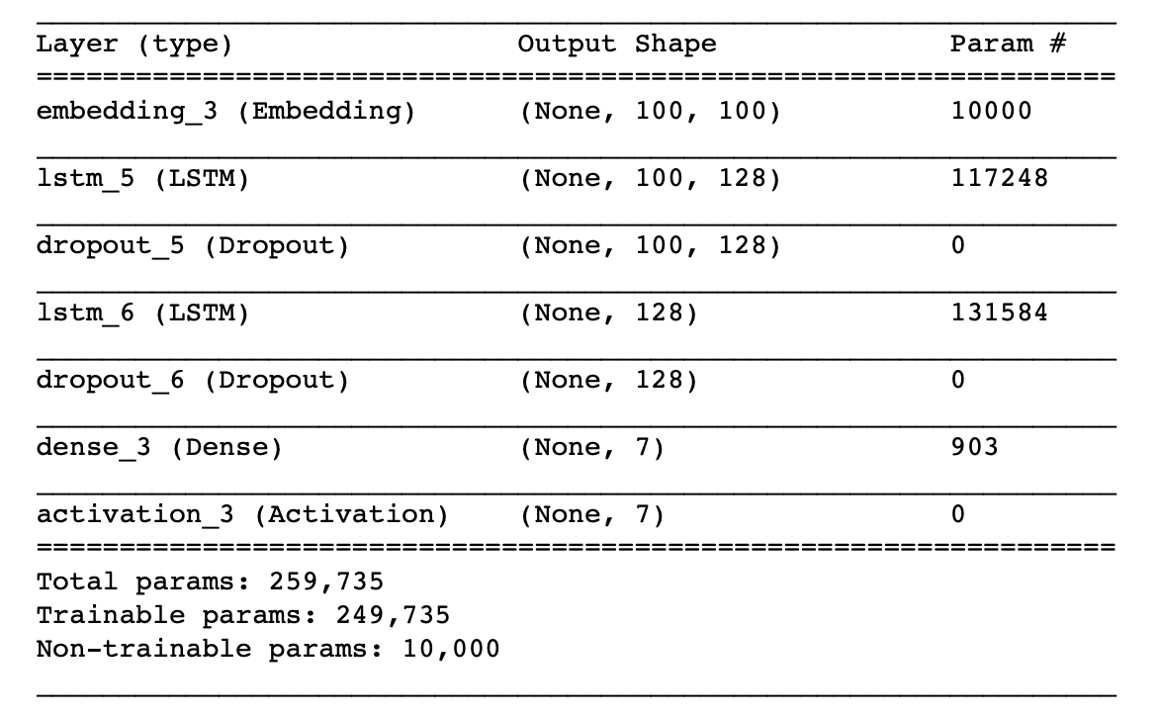
LSTM - Model Summary
Parameters:
Glove:
Embedding dim = 100
Vocabulary size = 100
Max length of document = 100
LSTM
loss='categorical_crossentropy'
optimizer='adam'
batch_size = 1000
epochs = 50
validation_split = 0.1
metrics=[metrics.mae, metrics.categorical_accuracy]

Slide 11
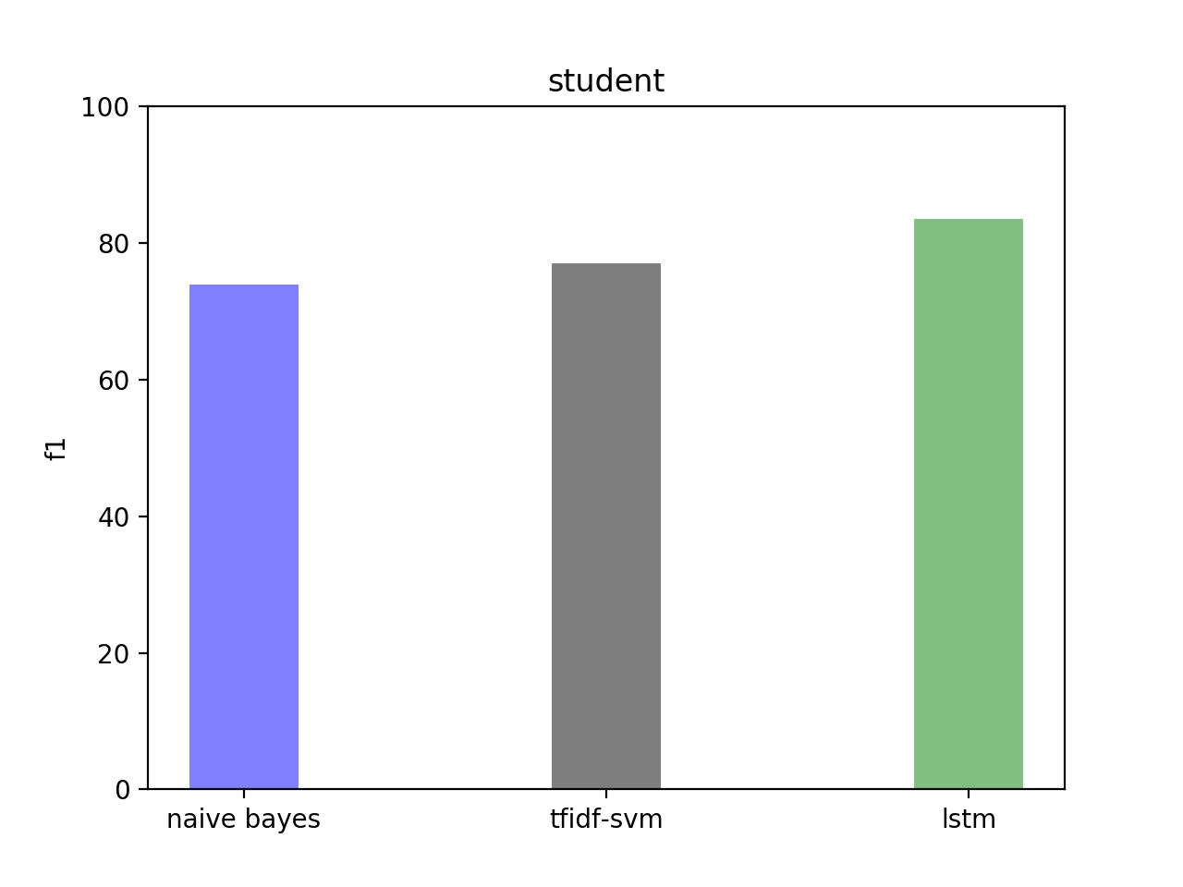
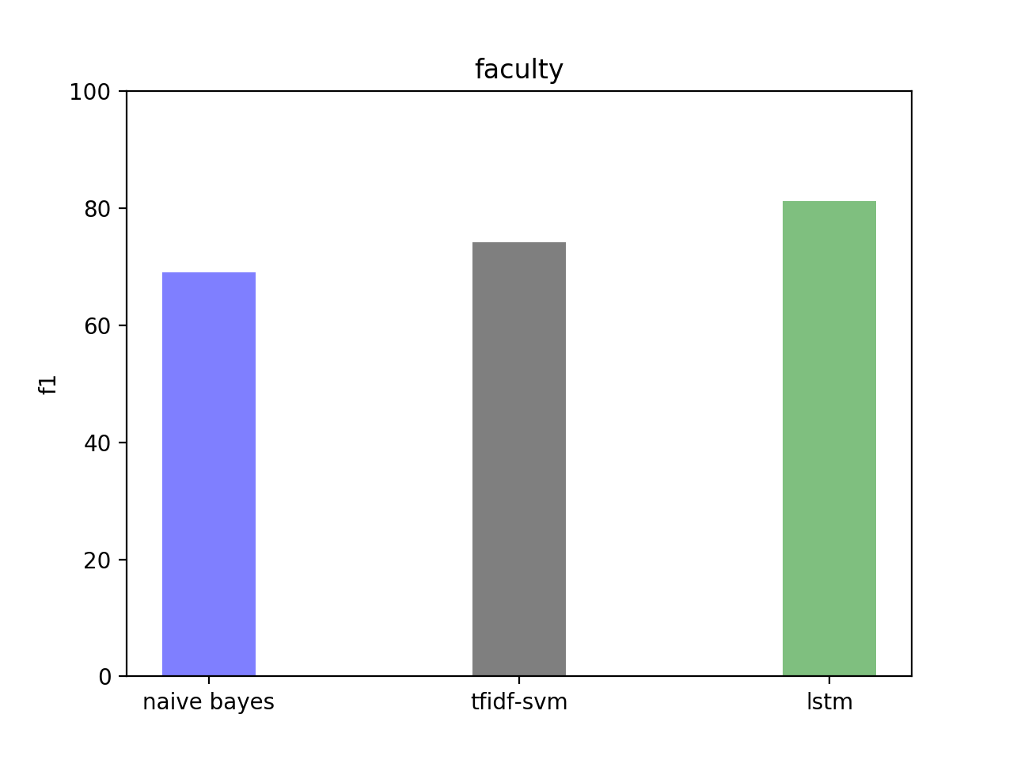
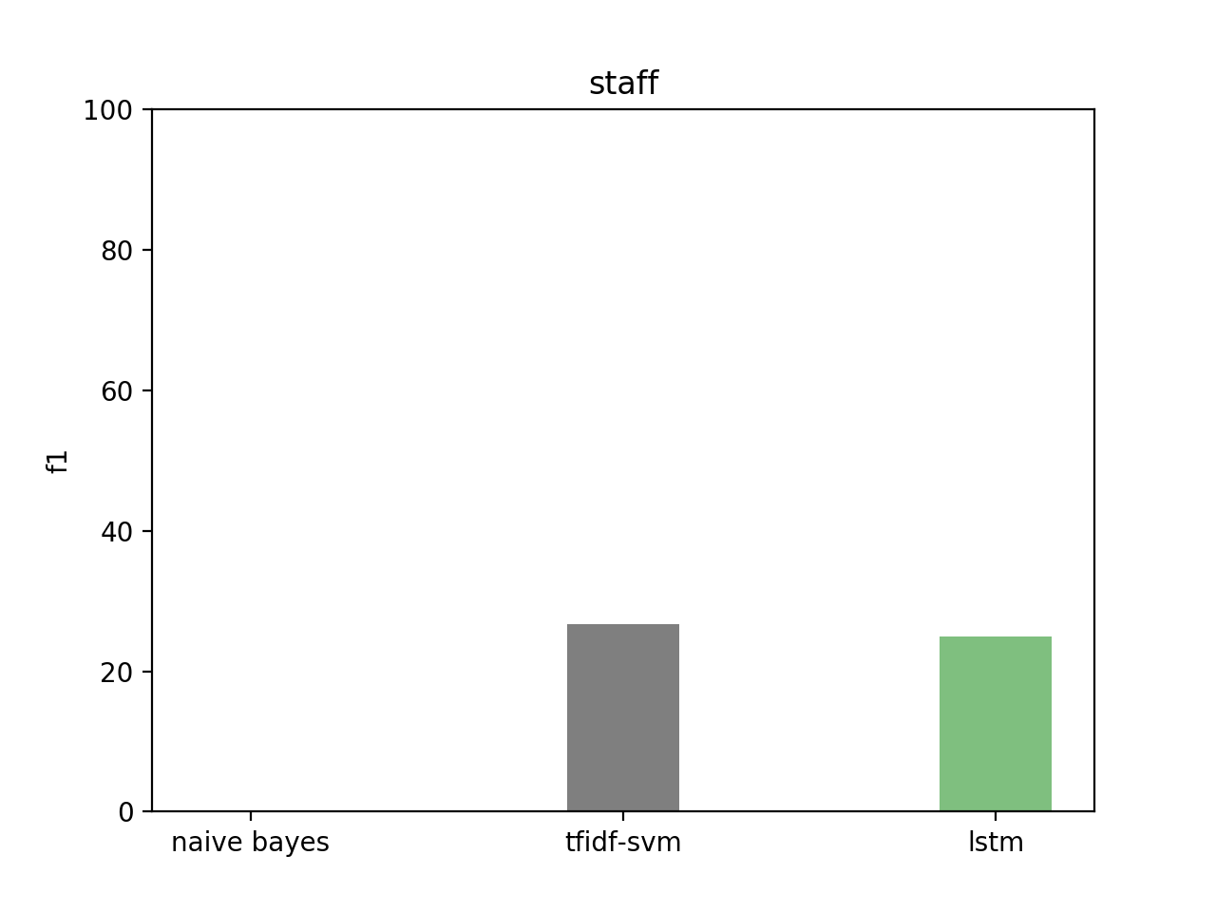
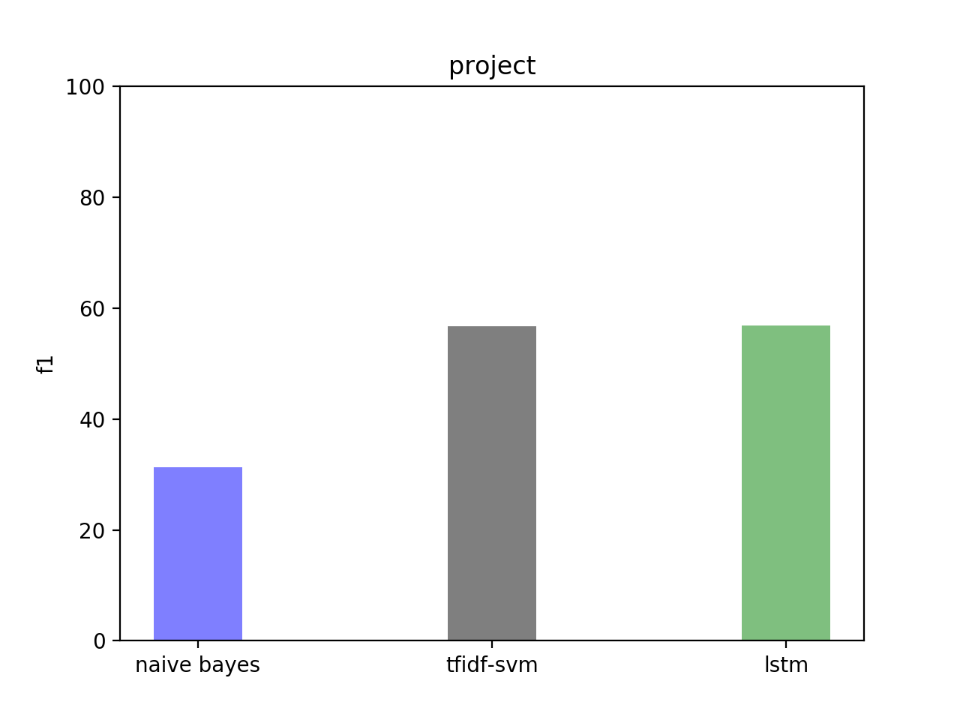
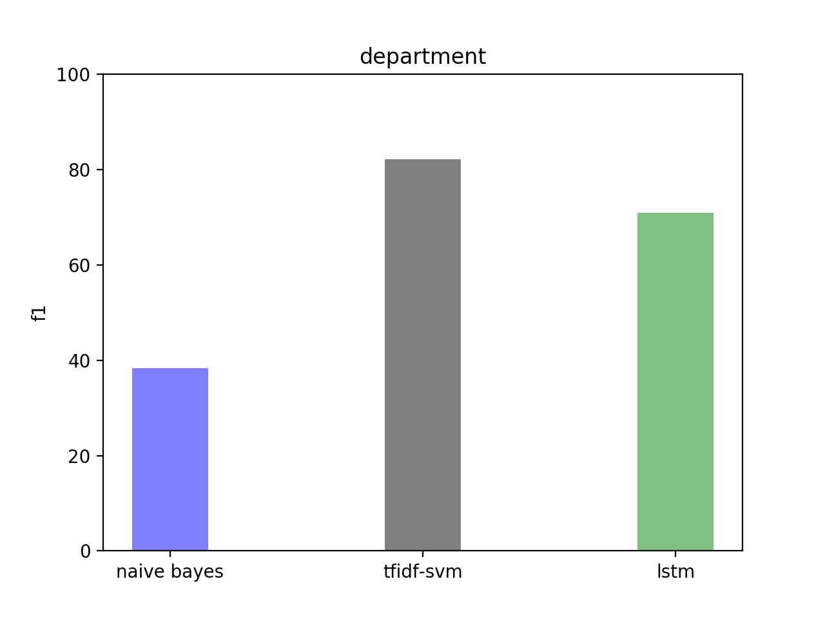
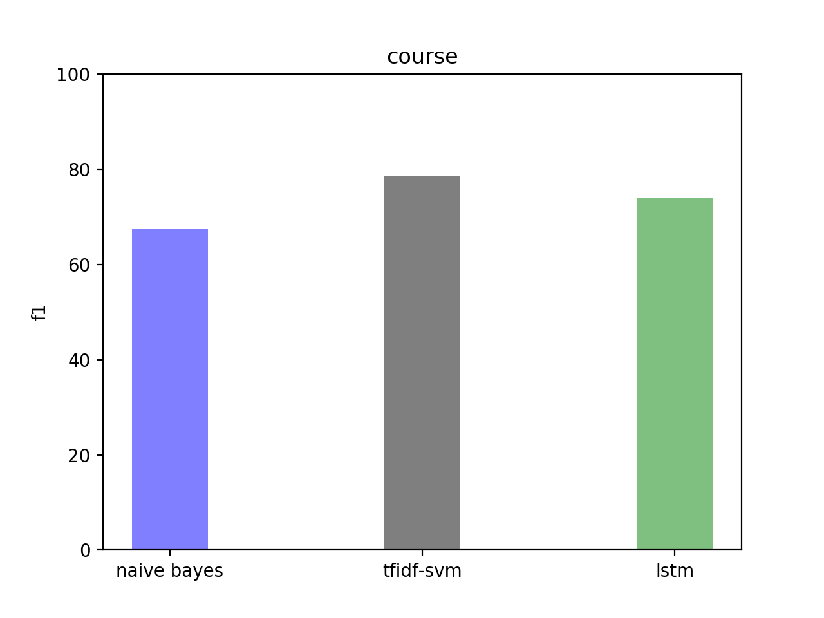
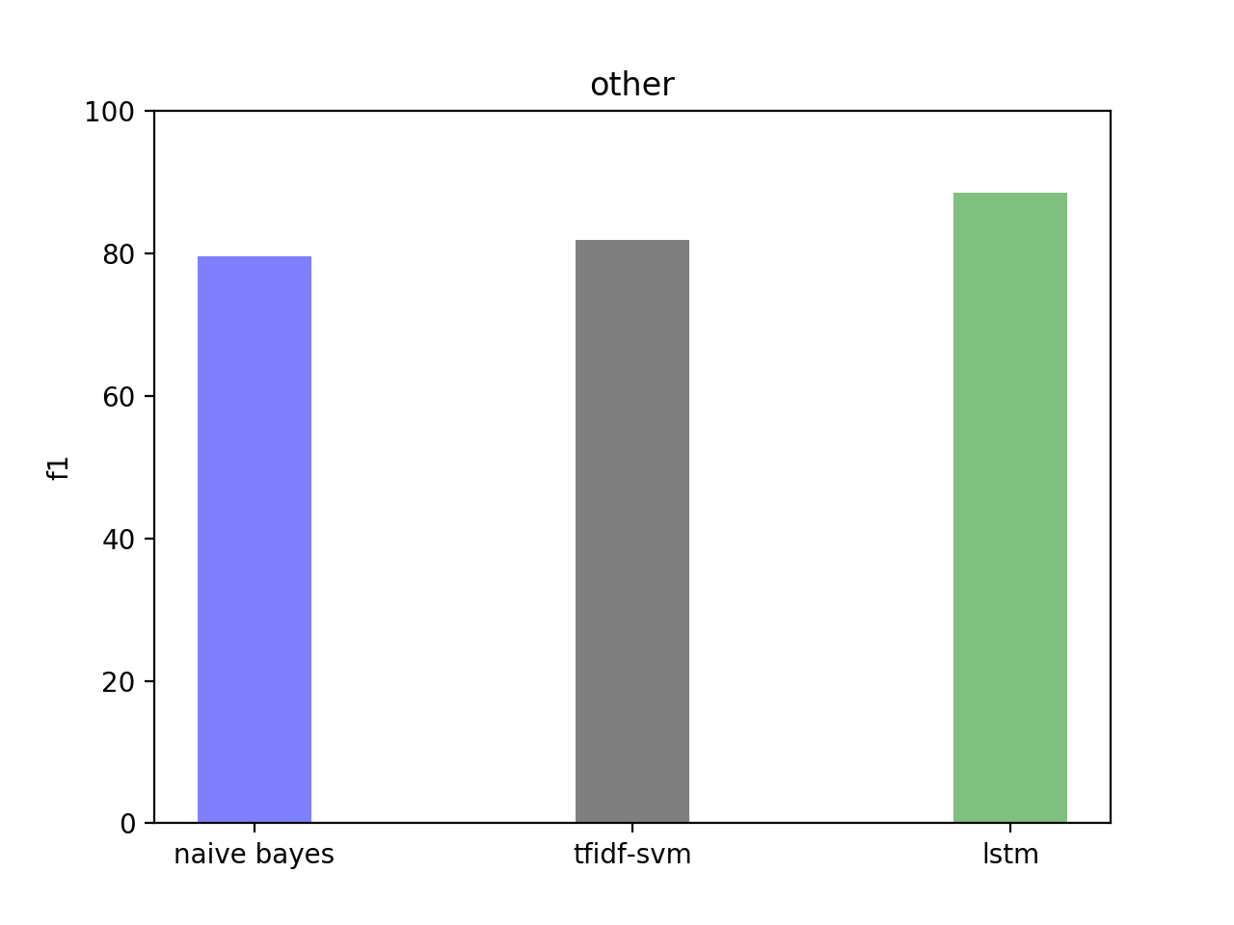
RESULTS (F1-measure) - After 5 fold CV

Slide 12
CONCLUSIONS
On average, F1-score for LSTM model is better for most of the entities.
Accuracy is highest for LSTM ( ~ 95% on average).
Not enough data to train the classifiers in case of ‘staff’ and ‘department’.
SVM always performs better than Naive Bayes. But LSTM is best.
Pre-trained GloVe embeddings performs better than trainable Word Embeddings.
SVM performs at par with LSTM as the dataset is not large enough for LSTM.

Slide 13
LIMITATIONS
Dataset size small for training LSTM.
Computational resource availability to train deeper neural network.
Exploration of ensemble methods.

Slide 14
FUTURE WORK
Establish relationship model between the entities
Use the relationship model for classification
Hyper-parameter Optimization of LSTM
Statistical tests for significance and effect size
Train Deep Learning module on larger amount of data
Exploration of other types of web page classification problem e.g. news websites

Slide 15
REFERENCES
[1] Freitag, D.\ (1998) Information extraction from HTML: Application of a general machine learning approach. AAAI/IAAI}.
[2] Furnkranz, J., Mitchell, T.\& Riloff, E. (1998) A case study in using linguistic phrases for text categorization on the WWW. { Working Notes of the AAAI/ICML}, { Workshop on Learning for Text Categorization}.
[3] Shen, D., Chen, Z., Yang, Q., Zeng, H., Zhang, B., Lu, Y., Ma, W. (2004), Web-page classification through summarization. { Proceedings of the 27th annual international ACM SIGIR 04 conference on Research and Development in Information Retrieval}, New York, ACM Press, pp:242- 249.
[4] McCallum, A.\ \& Nigam, K.\ (1998) A Comparison of Event Models for Naive Bayes Text Classification {AAAI Workshop},{ Workshop on Learning for Text Categorization}

